Slide 1
UE21CS320A – Capstone Project Phase-1 Review #3
(High Level Design and Proposed Methodology)
Project Title : Traffix: Dynamic Scheduling of Traffic
Signals Using Machine Learning
Project ID : 34
Project Guide : Dr. Mannar Mannan
Project Team : Kushaagra Shrivastava PES2UG21CS917
Harshita Khajuria PES2UG21CS194
Rishab A Kumar PES2UG21CS429
Rahul G Pai PES2UG21CS414

Slide 2
Outline
Abstract
Summary of Literature Survey
Suggestions from Review – 2
Proposed Methodology / Design Approach
Architecture
Design Description
Technologies Used
Project Progress
References

Slide 3
Abstract
The project aims to solve the problem of traffic congestion at signals by dynamically scheduling signals using machine learning and real time data processing.
We are introducing DTSA(Dynamic Traffic Scheduling Algorithm).
Taking an image of the map surrounding the signal, then logically slicing the circle into 3 sectors, based on pixel count.
This logical slicing of map is going to be converted into a 2d array form to be given to an SVM model for scheduling.
LSTM is also going to be added to this model for pre-emption of signals.
We Achieve this using a Client Server Architecture and Machine Learning Models (SVM and LSTM).

Slide 4
Literature Survey
Paper Details | Objective of paper, Techniques/Methods | Advantages | Limitations
Sai Charan Kanigolla, Chaitanya kumar Avala, Likhith Sai kuna, K.L.V. Sai Prakash Sakuru “Smart Traffic Detection and Control using Machine Learning Techniques” 2023 5th International Conference on Energy, Power and Environment: Towards Flexible Green Energy Technologies (ICEPE) | In the modern era, with the rise in vehicles and population, many urban cities have faced traffic problems like traffic congestion, which causes travel delays. The main reason for the delay is that current traffic systems use fixed signal timers at the traffic signal intersection. These unnecessary delays at the traffic signals lead to excessive fuel consumption and increased pollution. This paper uses vehicle detection methods through surveillance cameras and machine learning to predict traffic based on historical data in a region. Finally, optimizing traffic by utilizing the predicted data and proposed methodology reduces the average wait time of travellers. Done using Object detection. | Dynamically allocates signal time for a given lane using a traditional algorithm | Done only for one lane at a time, i.e., only 1 lane is free at a time and not multiple, the way it works in the real world Done only for a up front POV

Slide 5
Literature Survey
Paper Details | Objective of paper, Techniques/Methods | Advantages | Limitations
Nitin N. Sakhare, Subhash B. Tatale, Dr. S. R. Sakhare, Hemant Dusaane , Mamta Puri, Pratika Girme ,Rutuja Sankpal, Padmavati Ghule “Image Processing and IoT Based Dynamic Traffic Management System” International Journal of Scientific Research in Science Engineering and Technology(2020) | Due to rise in number of vehicles the traffic management has become a major problem. Manual traffic system is not efficient. This paper presents adaptive traffic management system using Internet of Things (IoT) and Image processing. The proposed system has capability to analyze real time data using image processing. Using cameras, different lanes are monitored constantly. The data obtained from different lanes are examined. Detection and counting of number of vehicles in each lane is done by using image processing. The count from each lane is sent to the central processing unit. According to the count of vehicles algorithm calculates waiting time for each lane, then the signal lights will be decided. This system reduces the average waiting time and increases the efficiency of traffic clearance. The system also reduces the pollution due CO2 emission and useful in emergency situations, thus being adaptive traffic management using Internet of Things (IoT) Methodology-Detects and counts number of vehicles from camera Calculates wait and go time based on that | Algorithm to greenlight lanes is present Dynamic adjustment of traffic lights for all lanes is present | Only greenlights 1 lane at a time.

Slide 6
Literature Survey
Paper Details | Objective of paper, Techniques/Methods | Advantages | Limitations
Abhay KP, Bhavik M, Narendra M, Saket CS, Prof. Ruby Dinakar “Smart Traffic Management and Control System” | The rapid increase in urbanization and population growth has led to an exponential increase in the number of vehicles on the road. This leads to higher traffic congestion. Traditional systems have struggled to keep up with this growth. Traditional traffic management systems are static in nature, they cannot adapt to incoming traffic in real time. This system uses real time data and algorithms to calculate and assign efficient traffic signal timings based on incoming traffic flow. This is done using image processing with the help of YOLO, and a traditional algorithm to assign signal timings. | Categorizing of vehicles into Big, Medium, Small using YOLO’s image recognition, assigning different weights to each class of vehicle and calculating how much traffic they would cause, then aggregating it all to get increase in signal timing | The algorithm is only applied where the signal is already green, and it would modify timings there. It also only calculated traffic until a certain point which could be extremely close to the signal itself. Its not reprioritizing lanes as traffic builds up in other lanes

Slide 7
Literature Survey
Paper Details | Objective of paper, Techniques/Methods | Advantages | Limitations
Neetesh Kumar, Syed Shameerur Rahman “Deep Reinforcement Learning with Vehicle Heterogeneity Based Traffic Light Control for Intelligent Transportation System” 2019 IEEE International Conference on Industrial Internet (ICII) | Objective of paper - to make dynamic traffic lights using deep reinforcement learning. Models - deep reinforcement learning using cnn and relu activation function. | It gives a basic idea of how reinforcement learning works for our project and how we can implement it on our test data. Has a pretty good result with 32% reduction in average wait time(validated through simulation | Data is from a radio - frequency identification sensor which isn’t easy to use and gives digital signals which needs to be read and deciphered. They haven't taken into account the size of vehicles and only taken position and speed of a vehicle. The size of a vehicle plays an important role in the traffic congestion.

Slide 8
Literature Survey
Paper Details | Objective of paper, Techniques/Methods | Advantages | Limitations
Marcin Korecki, Damian Dailisan, Dirk Helbing “How Well Do Reinforcement Learning Approaches Cope With Disruptions? The Case of Traffic Signal Control” IEEE Access ( Volume: 11) | Objective of the paper - to check how well reinforcement models work in cases of disruptions. (If a road is under construction etc.) Models - Reinforcement learning algorithms. | Advantages - It tells about the reinforcement model and how it is prone to disruptions and gives the solutions to the problem.(Analytic+ method is found to be the best). Analytic+ : An adaptive, self-organizing method relying on optimization and stabilization rules. Green times are varied | It is only a research paper on the limitations of reinforcement learning algorithms. Does not provide adequate insight on the models itself. It does not implement analytic+ method into ML models to test how well it integrates with existing models.

Slide 9
Literature Survey
Paper Details | Objective of paper, Techniques/Methods | Advantages | Limitations
Chen Zhang, Yugeng Xi, Dewei Li, Yunwen Xu “Data-Driven Model for Traffic Signal Control” 2018 37th Chinese Control Conference (CCC) | Objective of paper - to reduce the congestion time at traffic signals. Models - Hidden markov model. | It gives us a basic idea of how HMM can be used for our problem statement. They use HMM to get a dynamic approach which is what we are trying to implement. Works well for highly congested data. | They are using a prediction based approach to calculate the traffic congestion at a given time(which may or may not be true).

Slide 10
Summary of Literature Survey in Review 2
Paper 1: Image processing & IoT for lane monitoring & dynamic control (Single lane focus again).
Paper 2: Machine learning for traffic prediction & flow (Limited to single lane control).
Paper 3: Real-time data & algorithms for signal timing (Lacks dynamic lane prioritization).
Paper 4: Deep reinforcement learning (Ignores vehicle size impact).
Paper 5: Reinforcement learning for disruptions (Limited model clarity).
Paper 6: Hidden Markov Model (Relies on prediction for congestion calculation).
Overall:
Valuable insights for traffic management improvement.
Need for multi-lane control.

Slide 11
Suggestions from Review – 2
Removal of Emergency Services Preemption to Reduce Scope of project and Focus on Core Functionality

Slide 12
Design Details
Novelty
Traffic signal optimization by leveraging real-time traffic data from Google Maps
Applying machine learning algorithms to generate adaptive signal schedules.
Innovativeness
Dynamic adaptation to changing traffic conditions, where signal timings are continuously adjusted based on real-time data analysis
Performance
Capable of real time data processing
Reliable signal time output

Slide 13
Design Details
Security
Should be invulnerable to attacks trying to feed wrong data to models to mess up traffic signal timings
Dataset should be from accurate source
Portability
Platform-independent, allowing for deployment across different hardware environments and operating systems

Slide 14
Design Details
Legacy to modernization
Bridge between legacy traffic management systems and modern, data-driven approaches, facilitating the transition to more adaptive and efficient traffic control methods.
Reusability
Reusable components include machine learning models for traffic prediction and optimization, API interfaces for data integration, and modular software architecture for scalability and extensibility.

Slide 15
Design Details
Application compatibility
Compatible with common traffic management applications, including traffic signal controllers, traffic simulation software (e.g., SUMO)
Resource utilization, Etc.,
Optimizes resource utilization through efficient algorithms for real-time data processing, scalable cloud infrastructure for computational tasks, and bandwidth management for data transmission.

Slide 16
Proposed Methodology / Approach
Base Model:
We are building a classification model using SVM, the input for this model is taken from Image classification model.
The image classification model uses the images and slices it into 3 layers and gets different colors for the traffic density(VH,H,M,L,VL).
This data is converted into a matrix, which is taken as input for the SVM. The SVM takes the matrix and classifies it into a specific timer value(ranges from 30 to 180).

Slide 17
Proposed Methodology / Approach
Need for change:
The mentioned model never skips a lane during the output generation.
This can cause a increase in traffic congestion, but the model would be better than the existing traffic control system.
We can improve the model and add a pre-emption feature to the model.

Slide 18
Proposed Methodology / Approach
New Approach:
We are modifying the base model(SVM) by adding LSTM to it. This is done to improve the performance with respect to idle green lane conditions and improves overall traffic congestion.
The output from this new model will also be a specific timer value but the range is changed to 0-180. The 0 value helps a lot with the idle green lane condition, but it can also cause misclassification without enough training to the data.

Slide 19
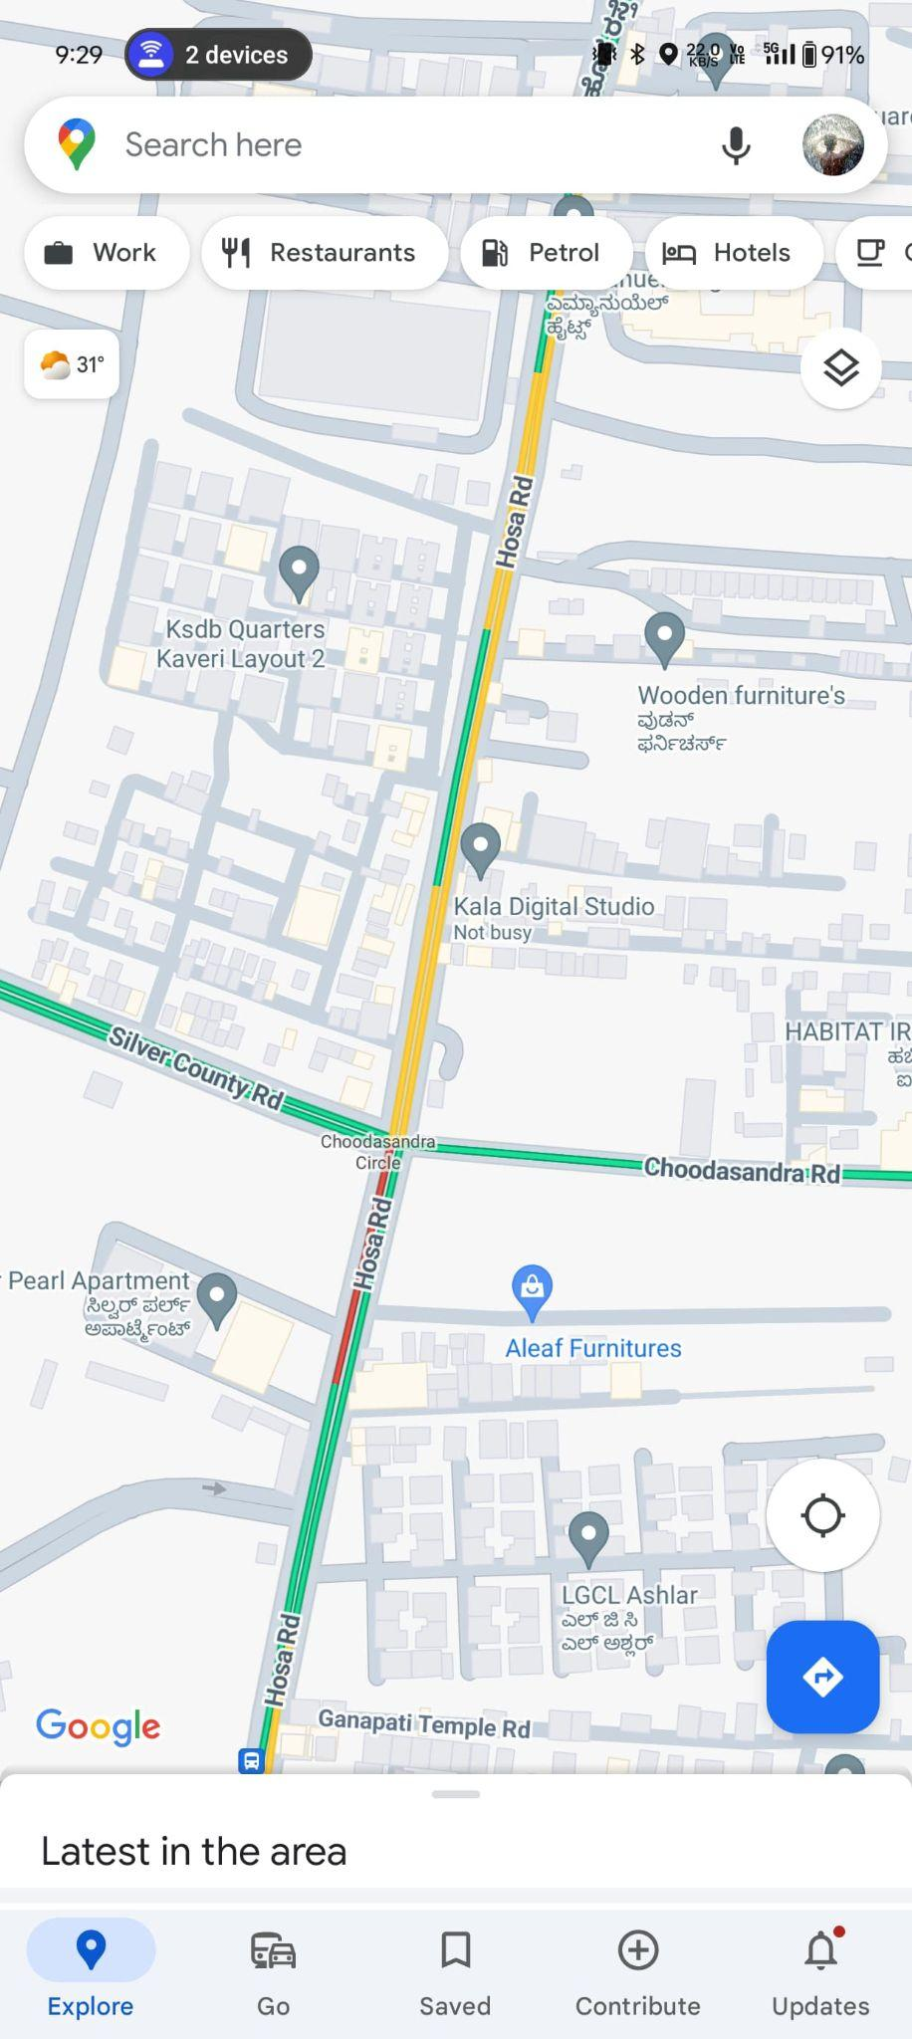
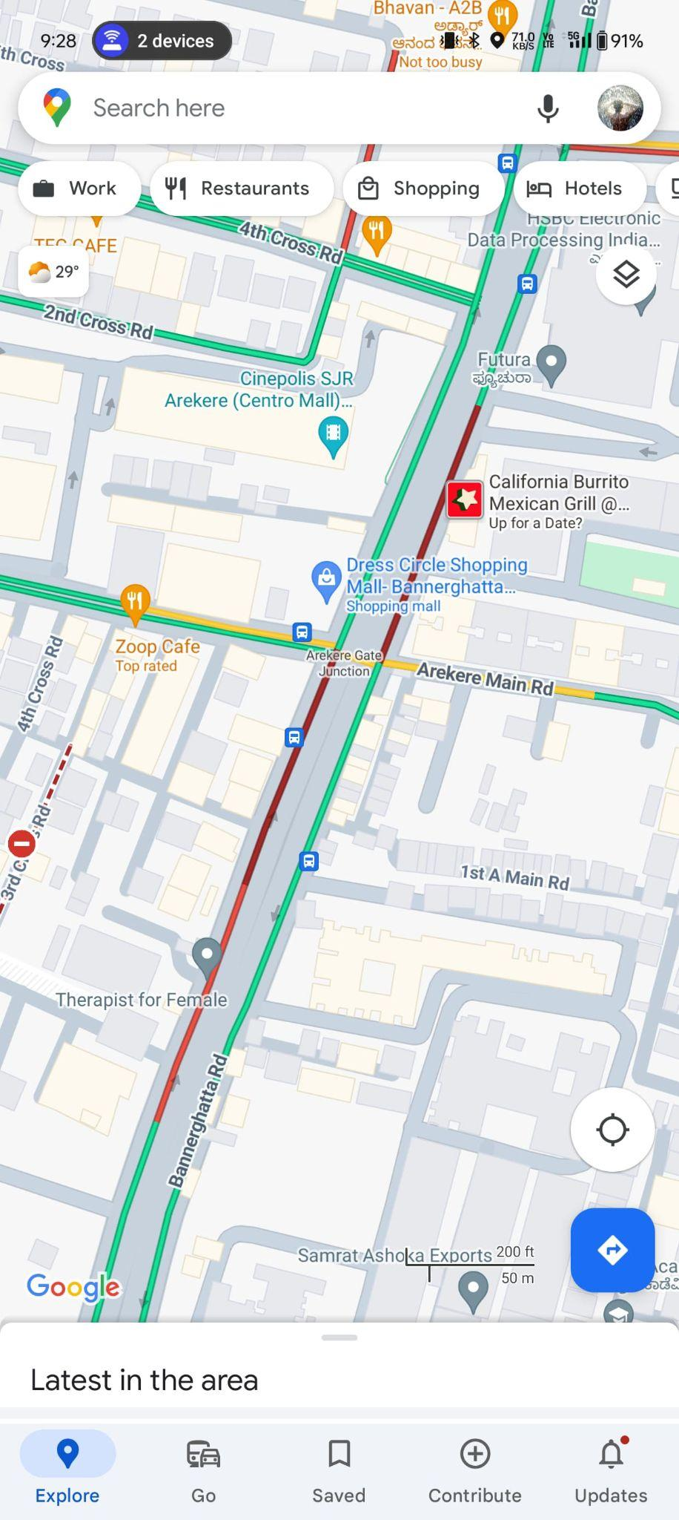

Slide 20
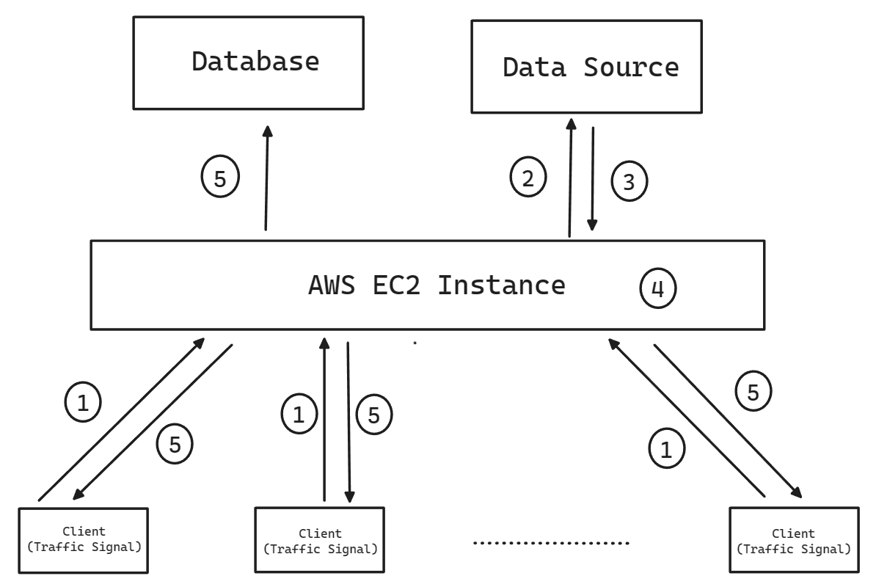
Architecture

Slide 21
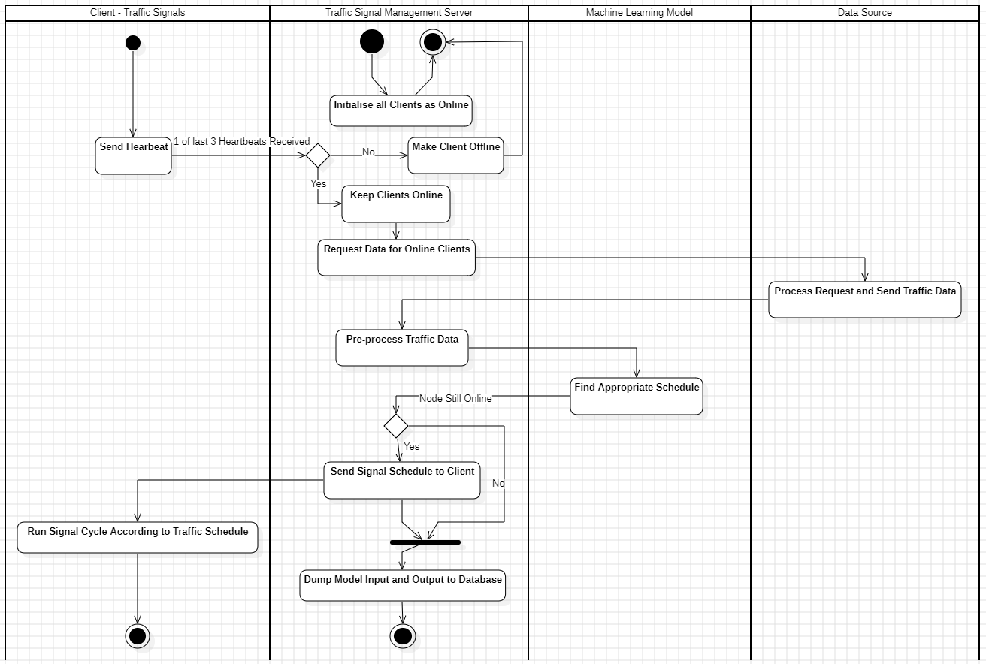
Architecture - Swimlane Diagram

Slide 22
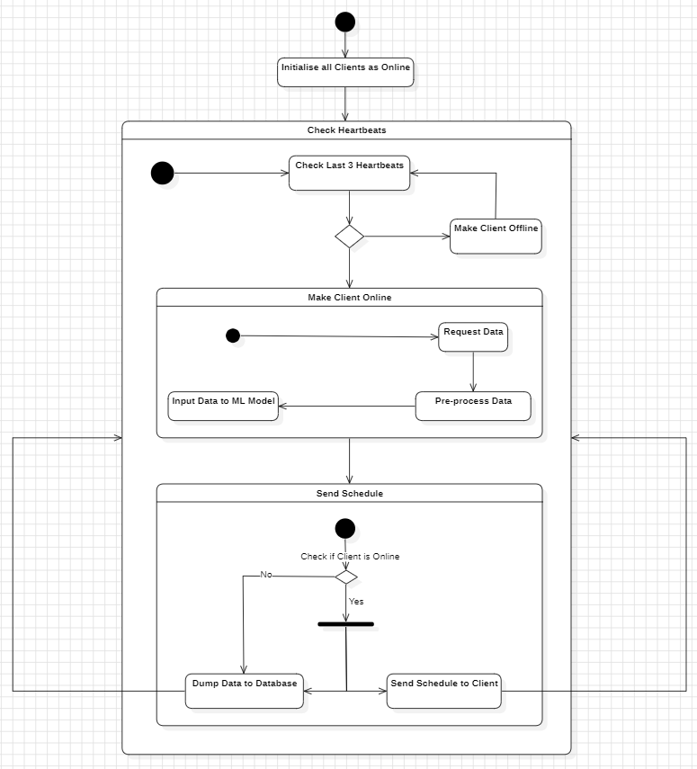
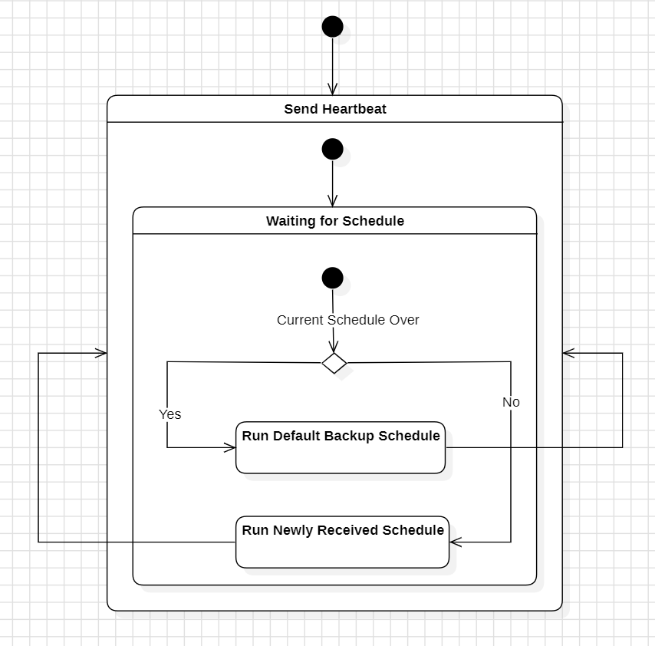
Architecture - State Diagrams
Server Client

Slide 23
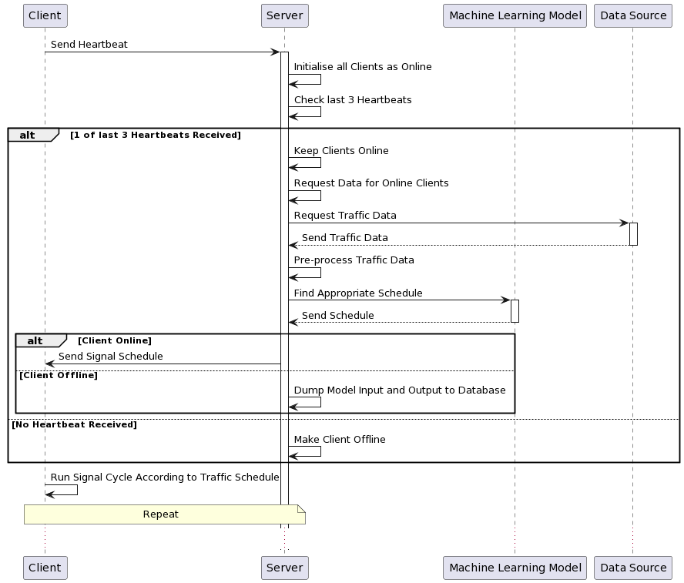
Architecture - Sequence Diagram

Slide 24
Technologies Used
Node JS - Seamless Integration with the Google Maps JS API Easily
Python Flask - Easiest to Use to make APIs
OpenCV - Image Processing
Google Maps JavaScript API TrafficLayer - To get traffic data
Amazon Web Services - For EC2 Instance to Run on the Cloud Reliably
SUMO - To simulate traffic flow and test our model.
SVM-For classification.
LSTM-For pre-emption for model

Slide 25
Project Progress
Model to be used has been finalized.
Approach has been finalized.
The JavaScript API has been separately tested.
Architecture to be used has been finalised.

Slide 26
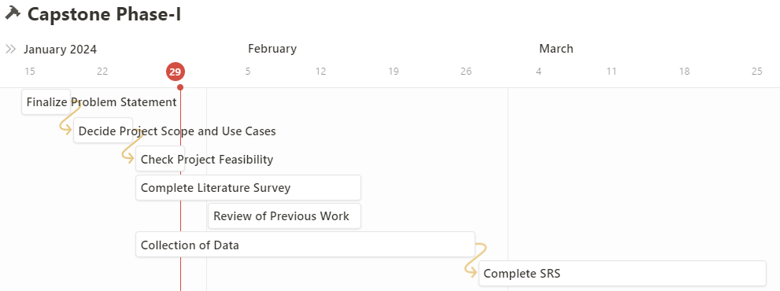
Capstone (Phase-I & Phase-II) Project Timeline
Provide
The timelines for execution of the project through Gantt chart.
The plan in terms of efforts by individuals in the team.
Mention the tasks involved in different stages.

Slide 27
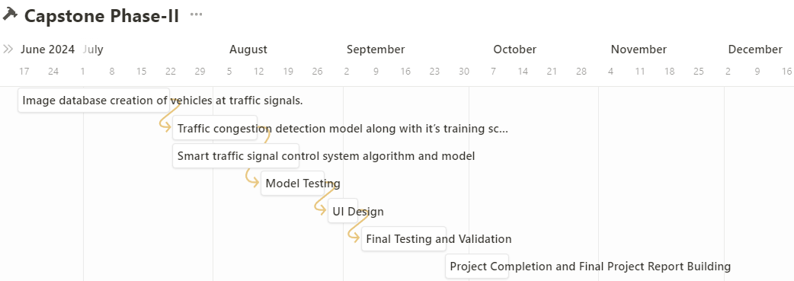
Capstone (Phase-I & Phase-II) Project Timeline
Provide
The timelines for execution of the project through Gantt chart.
The plan in terms of efforts by individuals in the team.
Mention the tasks involved in different stages.

Slide 28
Conclusion
The Base model will be implemented using SVM.
The addition of LSTM in order to enable pre-emption will be employed.
With the aid of these models, we aim to reduce congestion across various traffic signals, integrating various technologies, and in a manner that is relatively lightweight.

Slide 29
References
Sai Charan Kanigolla,Chaitanya kumar Avala,Likhith Saikuna, K.L.V. Sai Prakash Sakuru“Smart Traffic Detection and Control using Machine Learning Techniques” 2023 5th International Conference on Energy, Power and Environment: Towards Flexible Green Energy Technologies (ICEPE)
Nitin N. Sakhare, Subhash B. Tatale, Dr. S. R. Sakhare, Hemant Dusaane, Mamta Puri, Pratika Girme,Rutuja Sankpal, Padmavati Ghule“Image Processing and IoT Based Dynamic Traffic Management System” International Journal of Scientific Research in Science Engineering and Technology(2020)
Chen Zhang, Yugeng Xi, Dewei Li, Yunwen Xu “Data-Driven Model for Traffic Signal Control” 2018 37th Chinese Control Conference (CCC)
Neetesh Kumar, Syed Shameerur Rahman“Deep Reinforcement Learning with Vehicle Heterogeneity Based Traffic Light Control for Intelligent Transportation System” 2019 IEEE International Conference on Industrial Internet (ICII)
Marcin Korecki, Damian Dailisan, Dirk Helbing “How Well Do Reinforcement Learning Approaches Cope With Disruptions? The Case of Traffic Signal Control” IEEE Access ( Volume: 11)

Slide 30
Thank You

